Slide 1
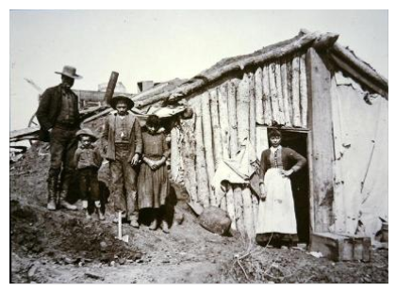

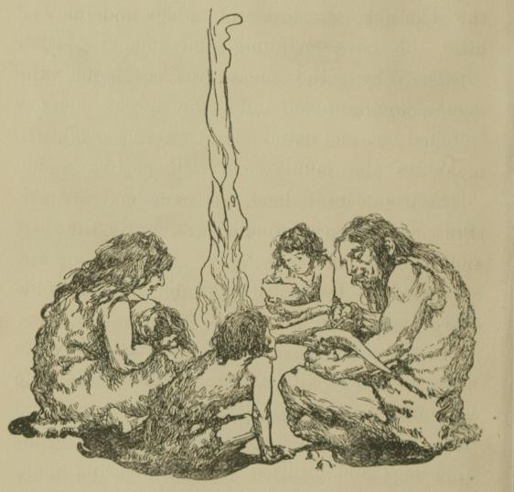
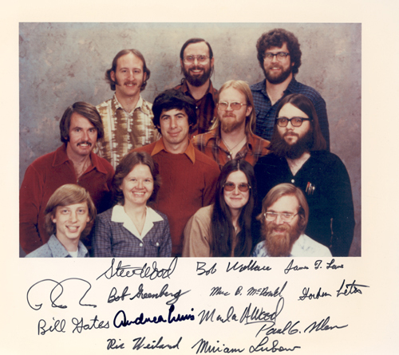
The Role and Importance of Social Identity in Successful Entrepreneurial Ventures

Slide 2
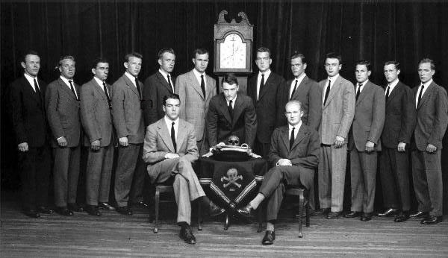
Introduction
What I am interested in:
Do non-founders feel develop strong social identity while working at a startup?
Does this influence their team and work?
Skull and Bones a secret society that provides a type of identity to its members, can you spot George Bush?

Slide 3
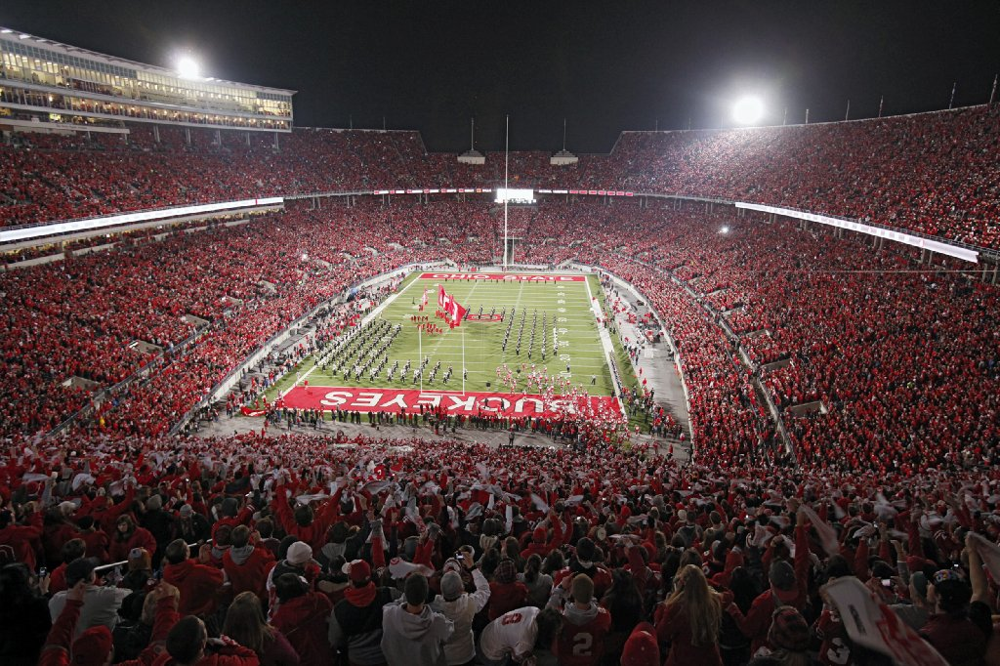
Introduction
Social identity is a driver of successful Entrepreneurial teams
What is social identity
This research looks at how social identity affects the startup and their motivation

Slide 4

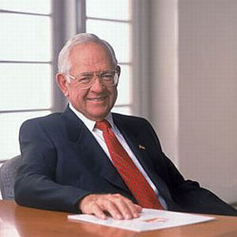


Literature Review and Previous Research
Individual entrepreneurs
Individual traits
Passion
Cognition
Entrepreneurs and teams
We will look at team motivation and identity
Notes:
Social environments are made up of communities, families, work teams, neighborhoods and other social groups that create a context for certain normative behaviors.

Slide 5
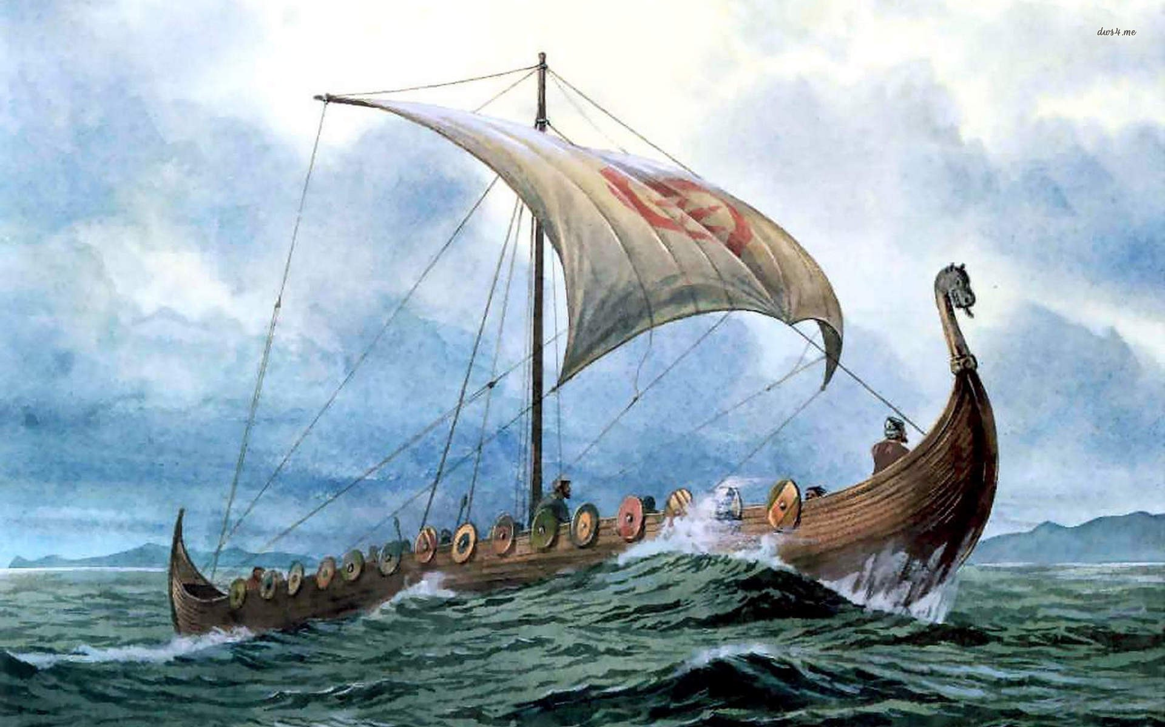
Literature Review and Previous Research
Social Identity Theory
Social environments (community, family, etc)
Cause Normative Behaviors
Self-Categorization- individual can categorize oneself as an object and be sort able into classifications
See groups as “us” and “them” often in psychology research see your group as superior
Viking raiders created a society where normative behavior felt raiding coastal settlements was a natural and “ok” function of society

Slide 6
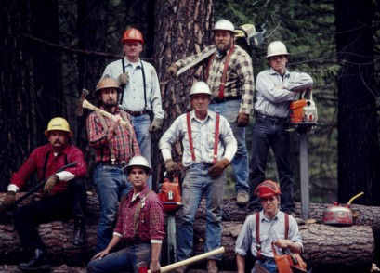
Theory Development
Establishing the Strength of Social Identity and Antecedents Affecting Identity
Hypothesis 1A: The amount of equity owned in a startup will have a positive effect on an individual’s identity with that organization
Hypothesis 1B: Owning clothing and firm related materials will have a positive effect on an individual’s identity with that organization
Hypothesis 1C: Direct access to the CEO will have a positive effect on an individual’s identity with that organization
Hypothesis 1D: Strong social connections among co-workers will have a positive effect on an individual’s identity with that organization.

Slide 7

Theory Development
Outcome of Strong Firm Identity
Hypothesis 2A: Workers at small start ups and entrepreneurial firms will identify with these firms. This will have a positive effect and allow them to work longer hours than those who do not identify with their work.
Hypothesis 2B: Workers with high organizational identity will view longer work hours as important and with clear outcomes since they are involved in their employment on a deeper level.
Hypothesis 2C: Those who identify will view the longer hours as self-chosen and also as directly benefiting them

Slide 8
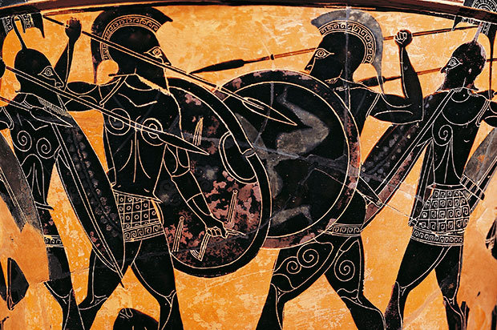
Methodology
Experimental Design
Small entrepreneurial firms
Survey based
200 respondents
Multiple regression based on 3 best models generated through AIC
Factor 2 (Social Assurance)
1. I feel more comfortable when someone is constantly with me.
2. I'm more at ease doing things together with other people.
3. Working side by side with others is more comfortable than working alone.
4. My life is incomplete without a buddy beside me.

